Slide 1
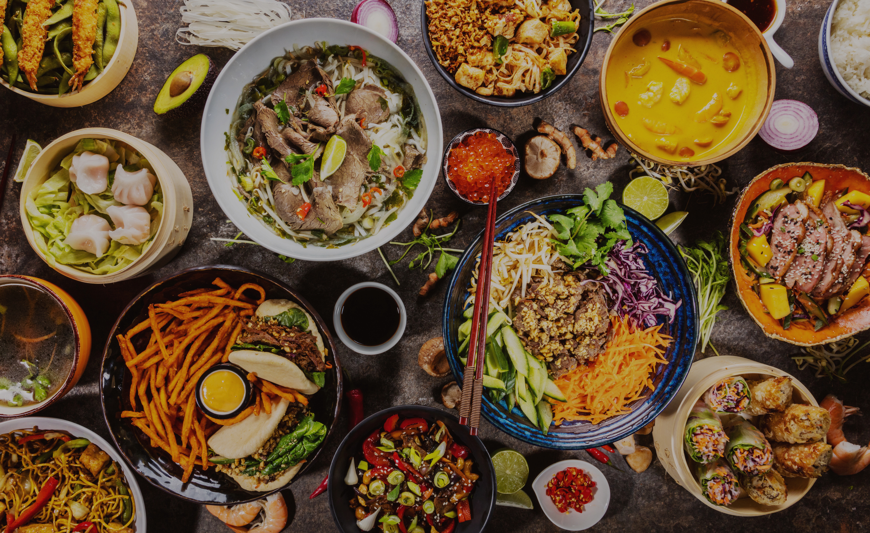

JG’S SMART
Canteen

Slide 2
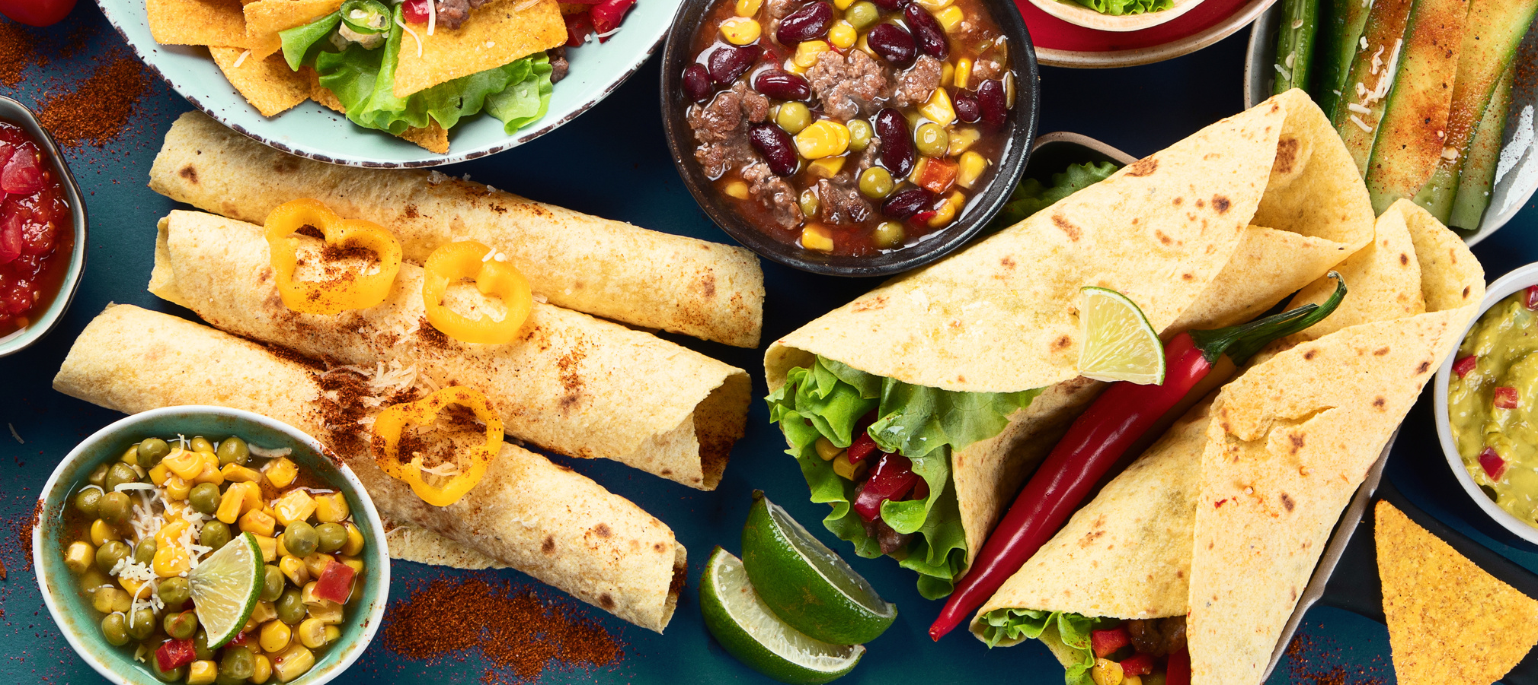
About
This project develops a responsive full-stack web application to digitize the college canteen ordering system. It reduces long queues, avoids manual errors, and provides real-time menu availability. Students can place orders online, while administrators can manage items and track orders efficiently, improving overall speed and convenience.
Food

Slide 3
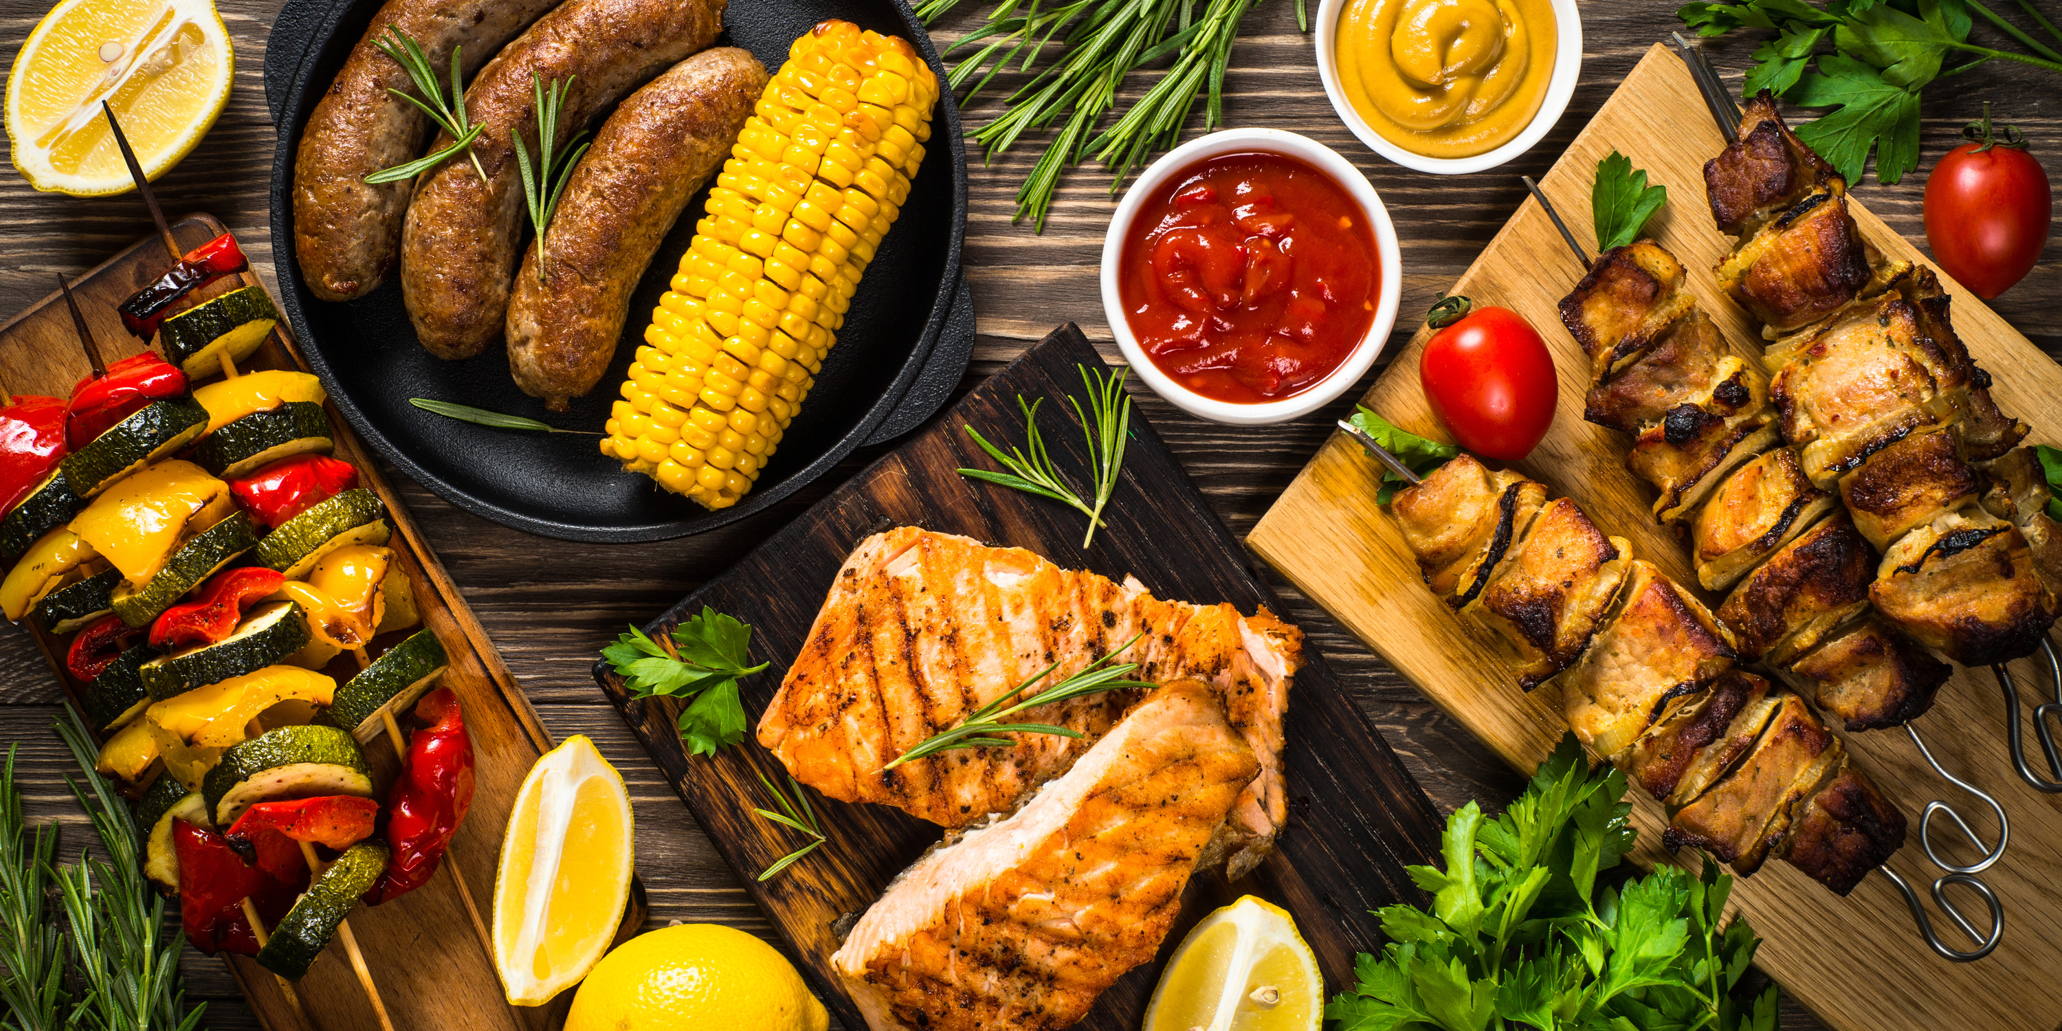
Welcome
Food
Welcome to the College Canteen Management System!
Easily browse the menu, check real-time availability, and place your order without standing in long queues. Our system is designed to make campus dining faster, smoother, and more convenient for everyone. Enjoy a smarter way to order your favorite meals! 🍽️

Slide 4
Smart
Screen
Digital Food Ordering & Management System
A responsive full-stack web application designed to:
Digitize college canteen operations
Reduce queues
Improve order tracking
Enhance food management efficiency

Slide 5



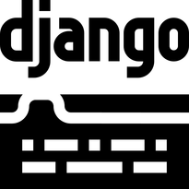


Technology
Used
Java Script
CSS (Tailwind)
DJango
HTML

Slide 6
System
Architecture
Overview
Full-Stack Implementation
Frontend: Responsive UI
Backend: Server-side logic & APIs (DJango)
Database: Dynamic data storage (SQL Lite)
Authentication: OTP-based login
Admin Panel: Food & order management

Slide 7
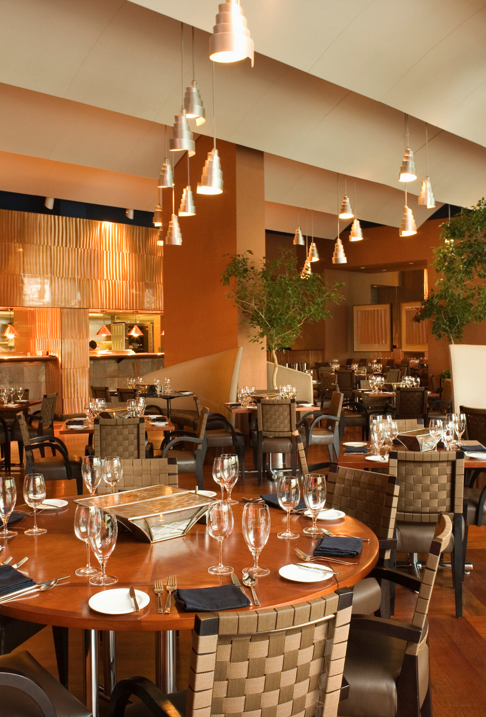
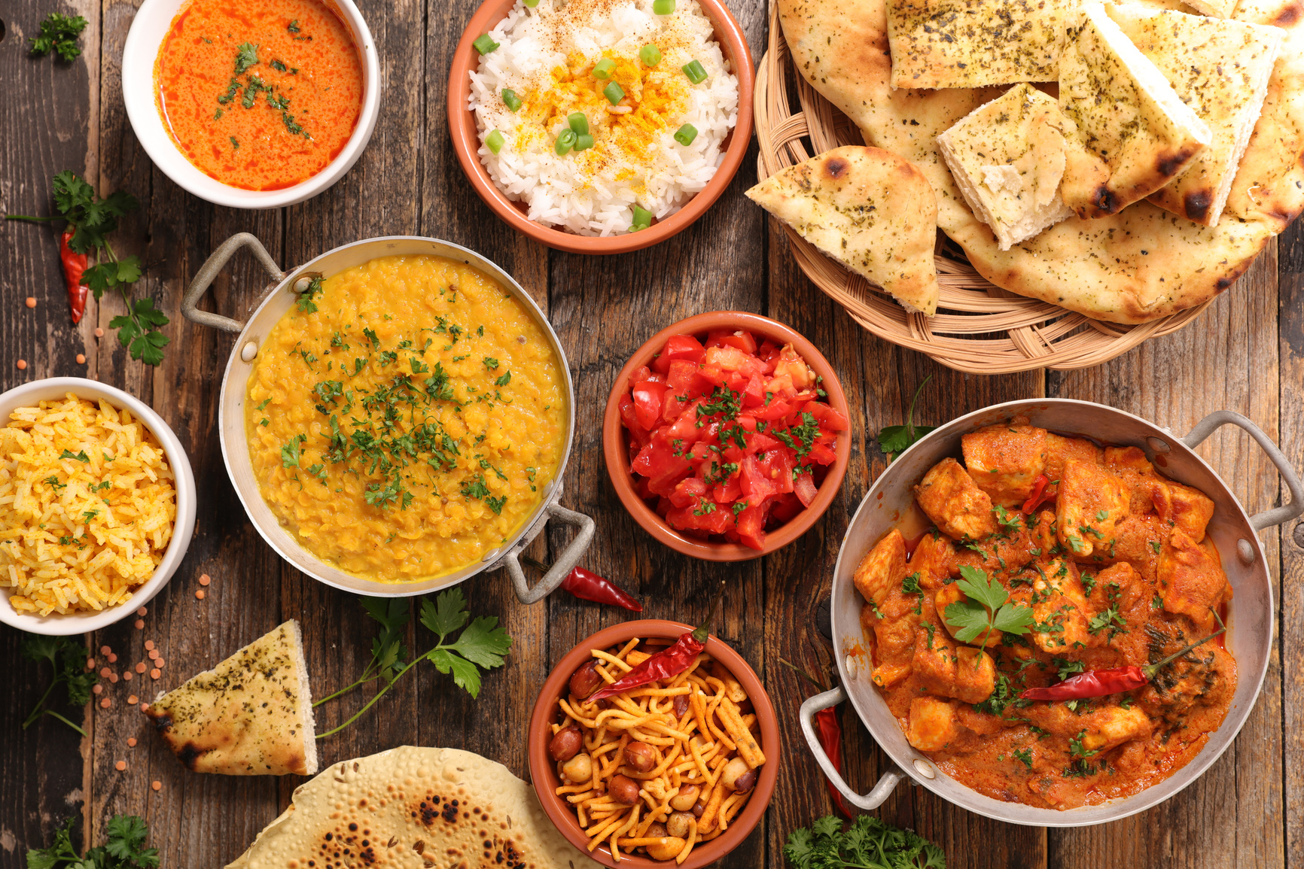
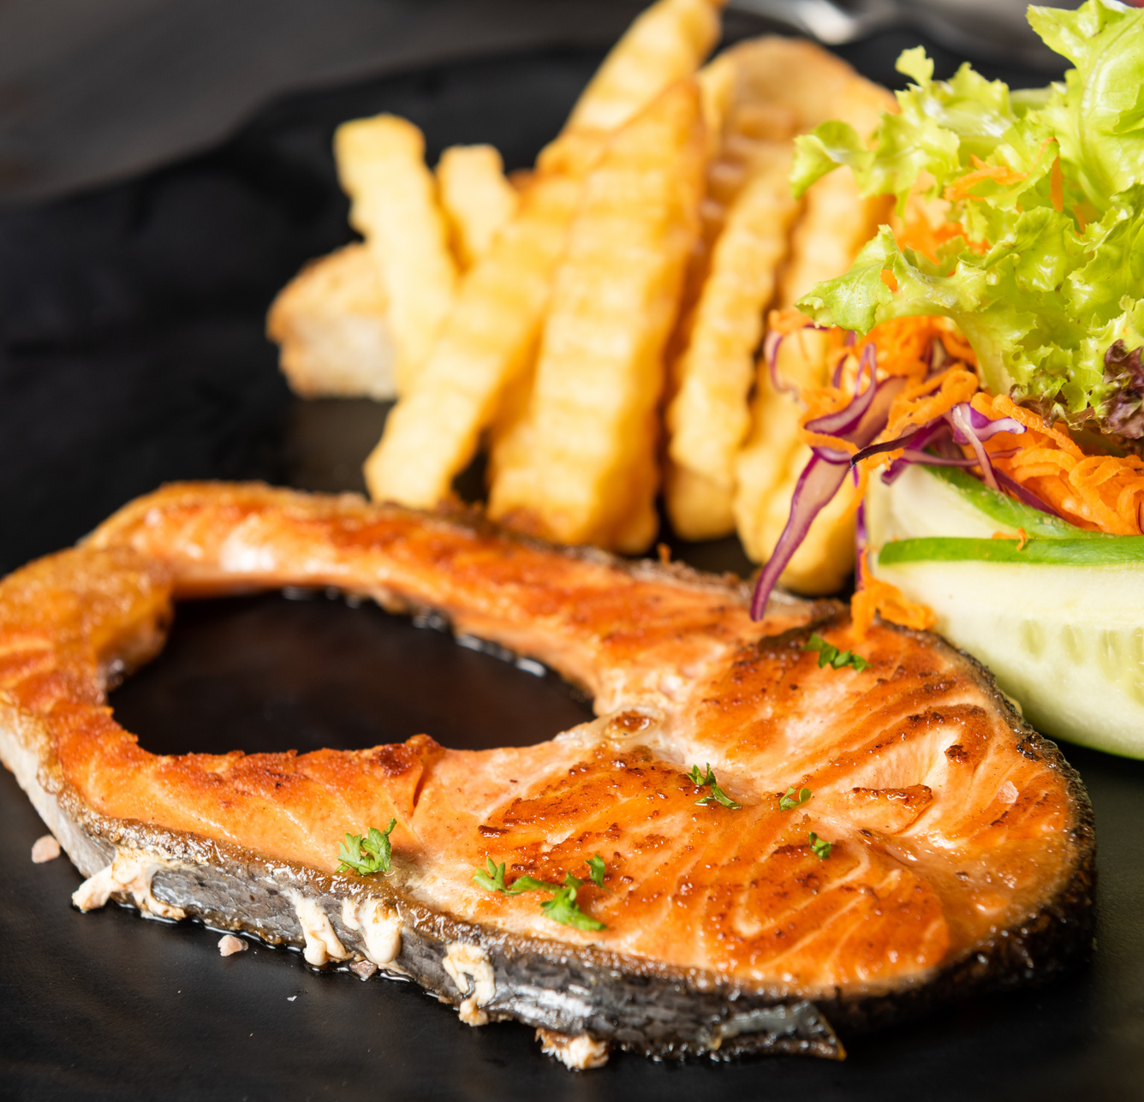
THANK YOU
for listening to our Presentation

